Slide 1
Big Data Fundamentals
Ajay J. Singala

Slide 2
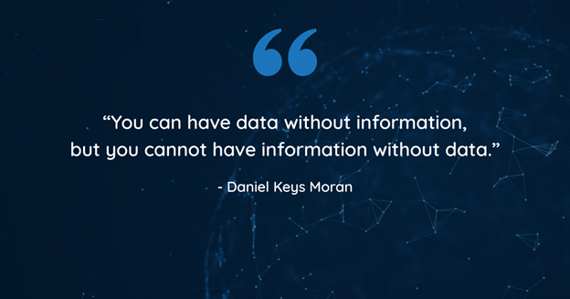

Slide 3
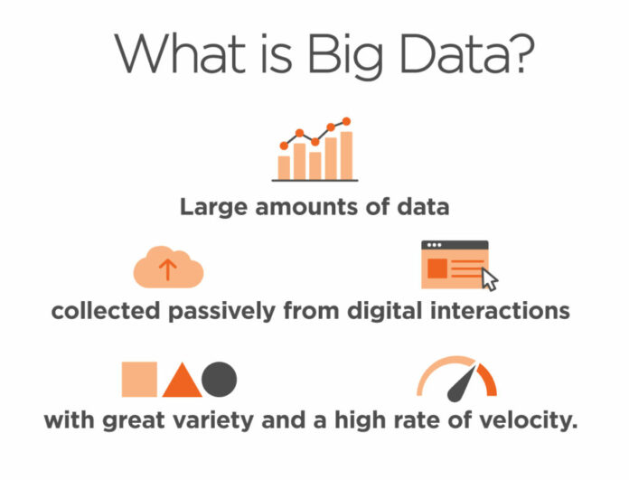
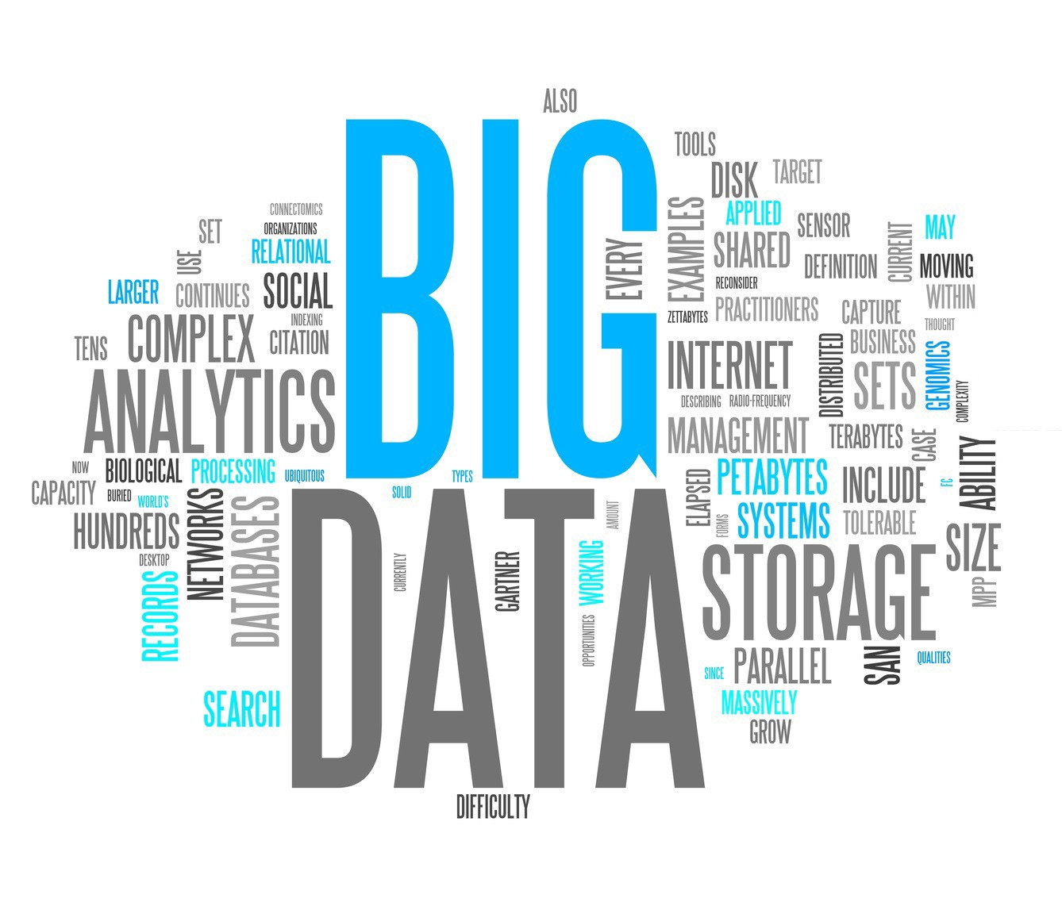
Story of Big Data
What is Big Data?
History of Big Data.

Slide 4
What is Big Data?
“The basic idea behind the phrase Big Data is that everything we do is increasingly leaving a digital trace which we can use and analyze to become smarter. The driving forces in this brave new world are access to ever-increasing volumes of data and our ever-increasing technological capability to mine that data for commercial insights.”
Bernard Marr, Author, Futurist, Tech Advisor
Big Data refers to the dynamic, large and disparate volumes of data being created by people, tools and machines. It requires new, innovative, and scalable technology to collect, host and analytically process the vast amount of data gathered in order to derive real-time business insights that relate to consumers, risk, profit, performance, productivity management and enhanced shareholder value.
EY
Big Data is high-volume, high-velocity, and/or high-variety information assets that demand cost-effective, innovative forms of information processing that enable enhanced insight, decision making and process automation.
Gartner
Big Data as a collection of data from traditional
and digital sources inside and outside a company
that represent a source of ongoing discovery and analysis.
Lisa Arthur, Forbes Contributor

Slide 5
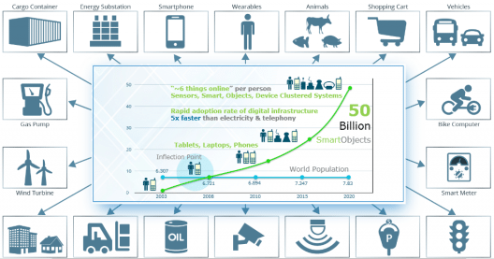
Big Data Driving Factors

Slide 6
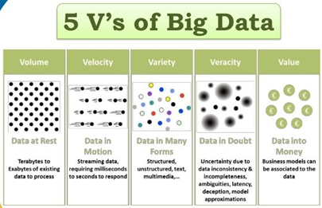
Big Data Characteristics
The Five V’s of Big Data
Volume
Variety
Veracity
Velocity
Value

Slide 7
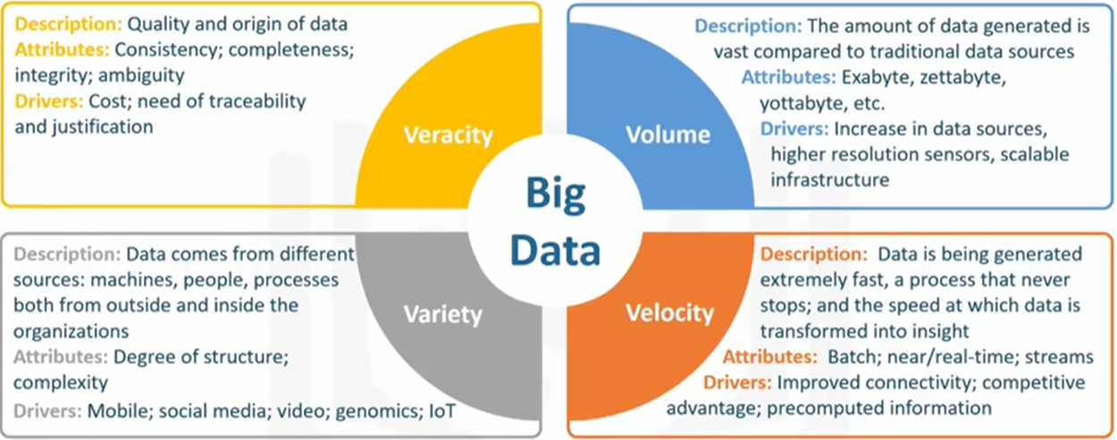
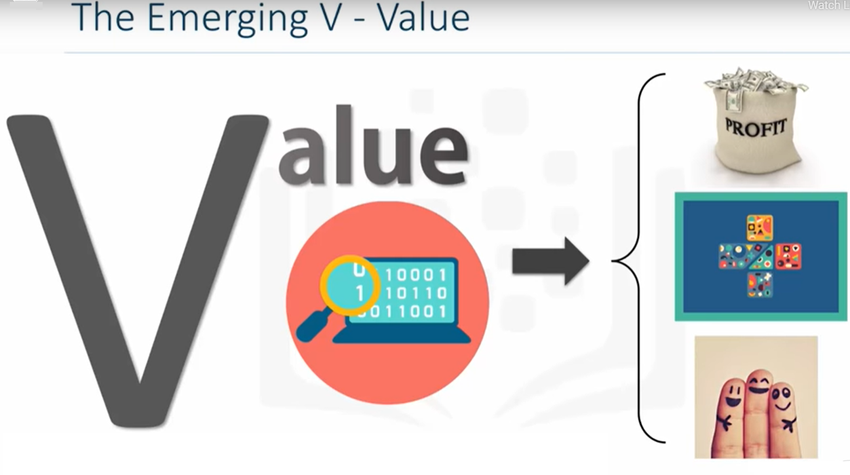
The 5 V’s of Big Data
The emerging V is value.
This V refers to our ability and need to turn data into value.
Value isn't just profit.
It may be medical or social benefits or customer, employee, or personal satisfaction.
The main reasons for why people invest time to understand
Big Data is to derive value from it.

Slide 8
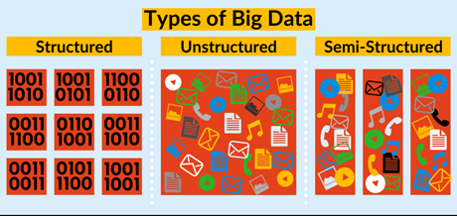
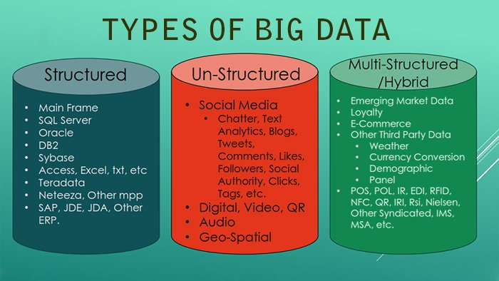
Types of Big Data
Structured
Semi-Structured
Unstructured

Slide 9
Applications of Big Data
Smarter Healthcare
Telecom
Retail
Traffic control
Manufacturing
Search Quality

Slide 10
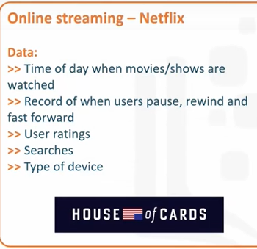
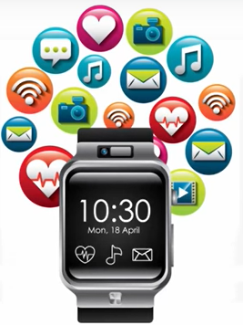
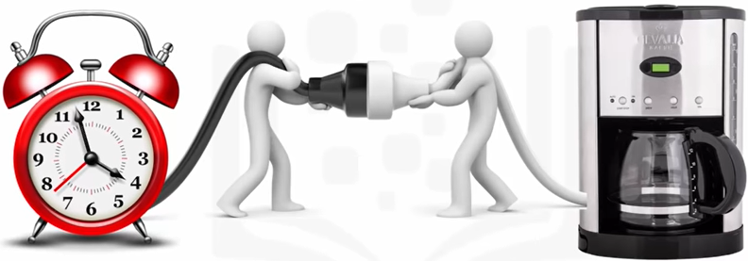
Big Data in Business
Impact of Big Data on Businesses and People
IoT

Slide 11
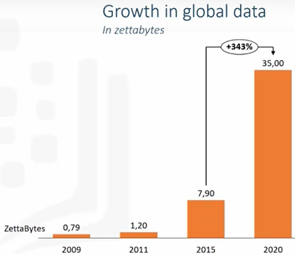
Beyond the Hype

Slide 12
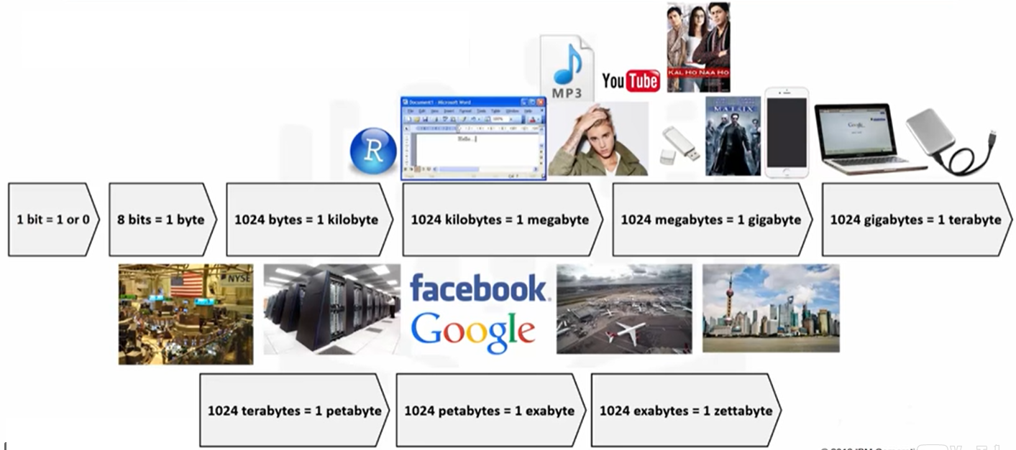
How big is a Zetabye?

Slide 13
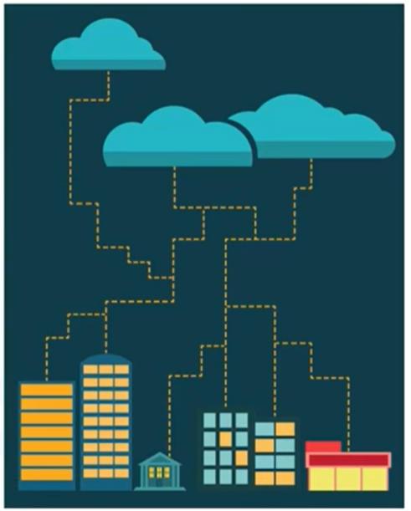
Cloud Computing
Advances in cloud computing have contributed to the increasing potential of Big Data.
According to McKinsey in 2013, the emergence of cloud computing has highly contributed to the launch of the Big Data era.
Cloud computing allows users to access highly scalable computing and storage resources through the internet.
By using cloud computing, companies can use server capacity as needed and expand it rapidly to the large scale required to process big data sets and run complicated mathematical models.
Cloud computing lowers the price to analyze big data as the resources are shared across many users, who pay only for the capacity they actually utilize.

Slide 14
Big Data Sources
Three major sources of Big Data:
People-generated data
Machine-generated data
Business-generated data

Slide 15
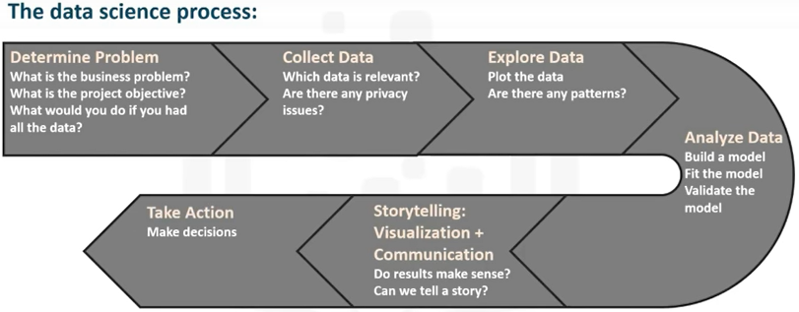
How to Make Sense of Big Data?
Data science is the process of cleaning, mining, and analyzing data to derive insights of value from it.
In data science, the size of the data is less important.

Slide 16
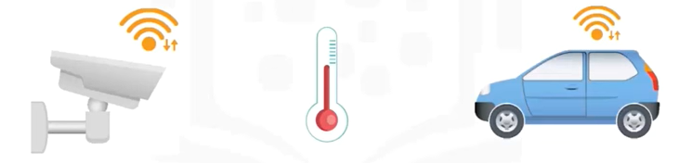
Examples of Big Data
Reducing Traffic Congestion
Deployed real-time Smarter Traffic system to predict and improve traffic flow.
Analyzed streaming real-time data gathered from cameras at entry / exit to city, GPS data from taxis, and trucks, and weather information.

Slide 17
Examples of Big Data
Customer Acquisition and Retention
Advertising Solutions and Marketing Insights
Risk Management
Innovations and Product Development
Supply Chain Management

Slide 18
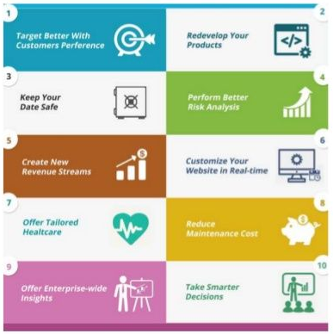
Benefits of Big Data
Big Data is generally processed by any Big Data Services Provider, and it has many benefits

Slide 19
Challenges with Big Data
Data Quality
Syncing Across Data Sources
Discovery
Storage
Analytics
Security
Lack of Talent

Slide 20
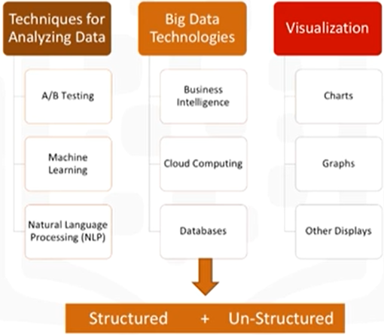
Components & Ecosystems of Big Data

Slide 21
Technologies & Tools to Help Manage Big Data
MapReduce
Apache Hadoop
Apache Spark
Apache Kafka
Apache Cassandra

Slide 22
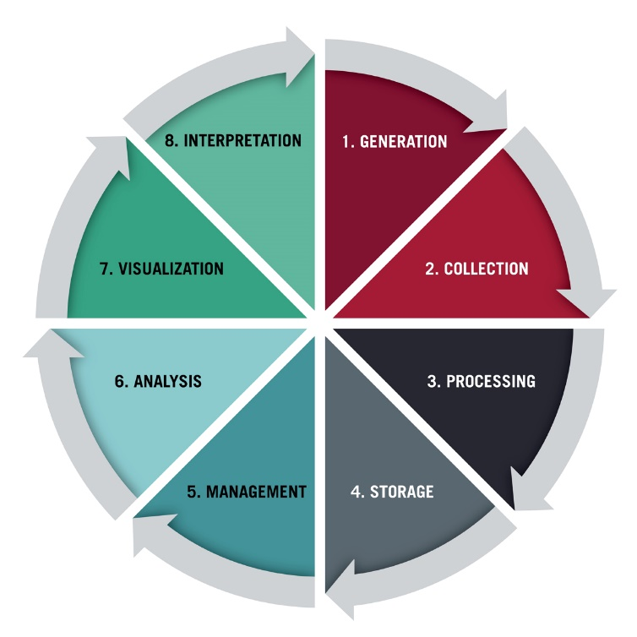
Data Lifecycle Stages
Generation
Collection
Processing
Storage
Management
Analysis
Visualization
Interpretation

Slide 23
5 Ways Companies are using Big Data to help their Customers
Predict exactly what customers want before they ask for it
Get customers excited about their own data
Improve customer service interactions
Identify customer pain points and solve them
Reduce health care costs and improve treatment

Slide 24
Big Data Case Studies
Walmart
Uber
Netflix
eBay
Procter & Gamble

Slide 25
Walmart
Largest retailer in the world.
Uses Data Mining to discover patterns.
The main objective of holding big data at Walmart is to optimize the shopping experience of customers when they are in a Walmart store.

Slide 26
Uber
First choice for people around the world when they think of moving people.
Uses the personal data of the user to closely monitor which features of the service are mostly used…
to analyze usage patterns and,
to determine where the services should be more focused.
Uber focuses on the supply and demand of the services due to which the prices of the services provided changes.

Slide 27
Netflix
The most loved American entertainment company.
Netflix has been determined to be able to predict what exactly its customers will enjoy watching with Big Data.
Netflix’s recommendation engines and new content decisions are fed by data points such as what titles customers watch, how often playback stopped, ratings are given, etc.

Slide 28
eBay
The company has been at the forefront of using big data solutions and actively contributes its knowledge back to the open-source community.
eBay is working with several tools including Apache Spark, Storm, Kafka. It allows the company’s data analysts to search for information tags that have been associated with the data (metadata) and make it consumable to as many people as possible with the right level of security and permissions (data governance).

Slide 29
Procter & Gamble
Procter & Gamble whose products we all use 2-3 times a day is a 179-year-old company.
P&G has put a strong emphasis on using big data to make better, smarter, real-time business decisions.

Slide 30
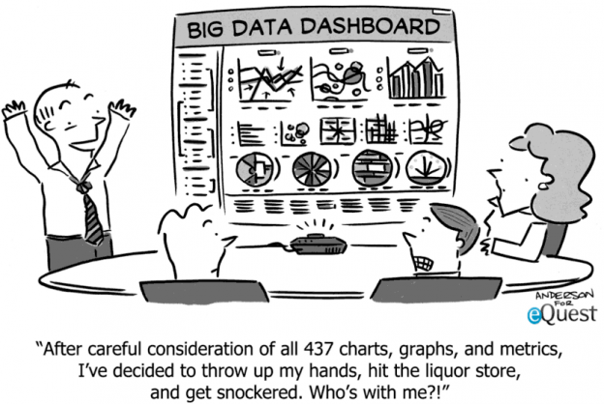

Slide 31

Thank you

